Slide 1
Updated Management on
Acne vulgaris

Slide 2
Acne vulgaris
Acne vulgaris is a chronic inflammatory dermatosis of the face and torso, characterized by open or closed comedones and inflammatory lesions including papules and pustules.
Zaenglein AL, Pathy AL, Schlosser BJ, et al. Guidelines of care for the management of acne vulgaris. J Am Acad Dermatol. 2016;74:945–973.

Slide 3
Pathogenesis
Acne vulgaris is a multifactorial condition characterized by-
Overproduction and changes in the composition of sebum
Epithelial hyper-keratinization of pilosebaceous duct with sebaceous obstruction
Cutibacterium acnes over-colonization and inflammation.
Ref:Anna Hwee Sing Heng & Fook Tim Chew, Systematic review of the epidemiology of acne vulgaris, Scientic Reports (2020) 10:5754

Slide 4
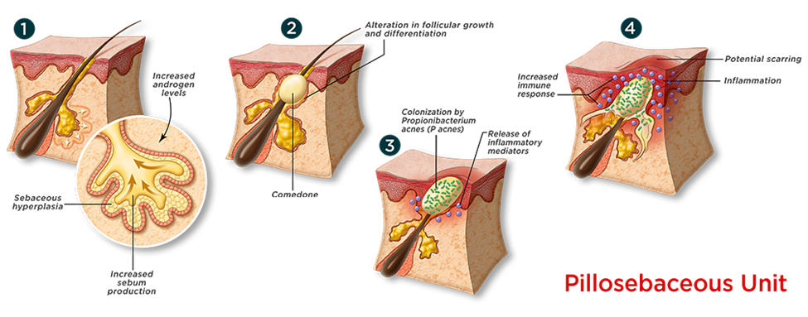
Acne pathophysiology
Ref: https://www.eternalskincare.ca/ESK-Blog/Acne-and-Blemishes

Slide 5
Epidemiology
Acne is the eighth most prevalent disease in the world affecting 10% of the world population¹
Affects approximately 85% of adolescents and young adults aged 12 to 25 years²
Prevalence of acne is higher in females than males
about 48–52% of facial acne patients also have truncal acne.³
1.Adelaide Hebert, MD; Diane Thiboutot, MD; Linda Stein Gold, MD; Martina Cartwright, PhD;Mara Gerloni, PhD; Enrico Fragasso, MS; Alessandro Mazzetti, MD: Ecacy and Safety of Topical Clascoterone Cream, 1%, for Treatment in Patients With Facial Acne, JAMA Dermatology June 2020 Volume 156, Number 6
2.Anna Hwee Sing Heng & Fook Tim Chew, Systematic review of the epidemiology of acne vulgaris, Scientic Reports (2020) 10:5754
3.Yu Ri Woo and Hei Sung Kim, Truncal Acne: An Overview, J. Clin. Med. 2022, 11, 3660

Slide 6
Contributing factors
Genetic predisposition
Diet-High glycemic diet
Cosmetics-Long term use of oil based cosmetics, Facial massage
Menstrual cycle
Psychological factor-Stress

Slide 7
Varieties of acne lesion
Acne vulgaris can be divided into
non- inflammatory (open and closed comedones)
and inflammatory (papules, pustules and nodules) lesions

Slide 8
Types of acne
Acne Conglobata
Occupational acne
Cosmetic acne
Drug-induced acne
Infantile acne
Late onset acne
Acne excoriee
Acne fulminans
Post-facial massage acne

Slide 9
Differential diagnosis
Rosacea
Perioral dermatitis
Folliculitis
Hidradenitis suppurativa

Slide 10
Management
General measures
Maintain local hygiene
Avoid high glycemic food
Reduce stress

Slide 11
Patient Evaluation
Key Elements in History
previous medications used
current products being used for acne
medical problems
other medications
use of cosmetics or hair pomades
recreational activities and occupation

Slide 12
Management
Acne vulgaris can be treated either topically or systemically.
Topical therapy
Systemic therapy

Slide 13
Topical Therapy
Anti Comedonal Agents
Topical Retinoids
Azelaic acid
Salicylic acid
Anti Inflammatory Agents
Benzoyl Peroxide
Topical antibiotics

Slide 14
Systemic therapy
Oral Antibiotics
Isotretinoin
Hormonal Therapy

Slide 15
Oral Antibiotics
Tetracycline
Doxycycline
Minocycline
Erythromycin

Slide 16
Hormonal Therapy
Oral contraceptives pill
Spironolactone

Slide 17
Challenges in the management of Acne vulguris
Benzoyl peroxide -> has an irritant effect on skin-> Poor adherence
Retionoids-> associated with adverse effects like local irritation, erythema and must be used with caution in females of childbearing age owing to known teratogenicity.
Topical and oral antibiotics->Raising antibiotic resistance leads to poor therapeutic outcome
Hormonal therapy->associated with a relative increase in certain cardiovascular risk factors & contraindicated in males and in pregnancy.

Slide 18
Role of androgen in acne pathogenesis
Androgens, especially DHT are shown to induce both sebaceous gland growth and increased sebum production.
Creates a nourishing medium in which anaerobic C. acnes bacteria can flourish.
Acne pathogenesis

Slide 19
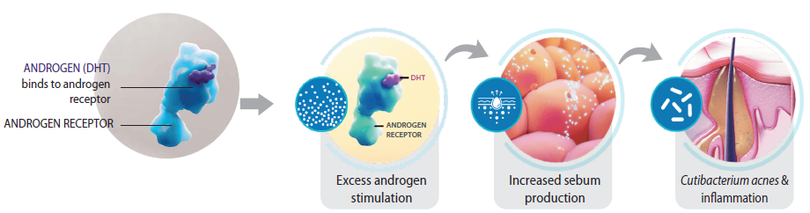
Androgen receptor pathway

Slide 20
Addressing Androgen pathway to treat Acne
Androgen inhibition is also an effective strategy for the treatment of acne.
Current anti-androgen drug therapies include
    oral contraceptives
    Spironolactone
    Flutamide
    Finasteride
However, their use can be associated with systemic adverse events and are unsuitable for use in males with acne.

Slide 21
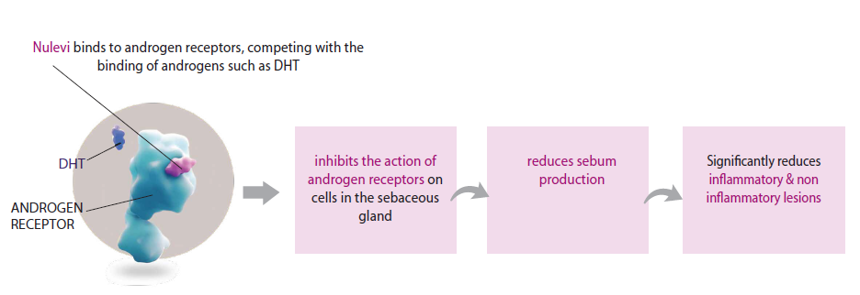
Clascoterone-A novel topical antiandrogen for acne vulgaris
Clascoterone 1% cream is a steroidal topical androgen receptor inhibitor which work through competitive inhibition of DHT receptors within the sebaceous glands and hair follicles
Adelaide Hebert, MD; Diane Thiboutot, MD; Linda Stein Gold, MD; Martina Cartwright, PhD;Mara Gerloni, PhD; Enrico Fragasso, MS; Alessandro Mazzetti, MD: Ecacy and Safety of Topical Clascoterone Cream, 1%, for Treatment in Patients With Facial Acne, JAMA Dermatology June 2020 Volume 156, Number 6
Notes:
Kindly add the literature pic.

Slide 22
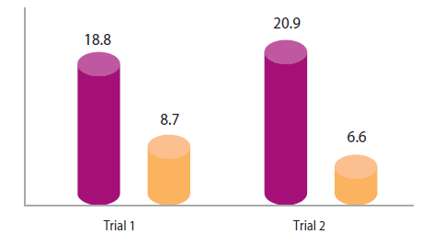
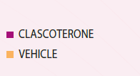
Clinical efficacy
In two identically-designed, multicenter, randomized, double-blind, vehicle-controlled clinical trials Clascoterone demonstrated significant reduction in facial & truncal acne in Investigator’s Global Assessment (IGA) Score from ≥2 to ≤1 in just 12 weeks.
M. H. GOLD, Clascoterone cream (1%) topical androgen receptor inhibitor for the treatment of acne in patients 12 years and older, EXPERT REVIEW OF CLINICAL IMMUNOLOGY 2021, VOL. 17, NO. 4, 301–308

Slide 23
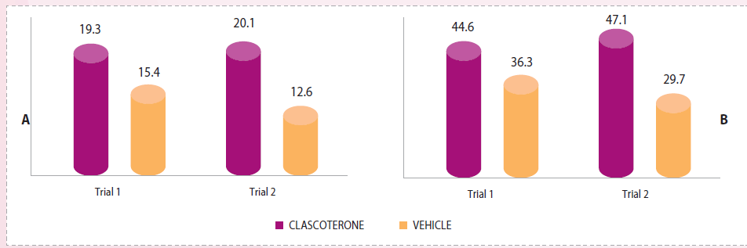
Clinical efficacy
Clascoterone was more effective than application of vehicle cream at achieving IGA success and reducing NILC and ILC in patients with facial acne vulgaris.
M. H. GOLD, Clascoterone cream (1%) topical androgen receptor inhibitor for the treatment of acne in patients 12 years and older, EXPERT REVIEW OF CLINICAL IMMUNOLOGY 2021, VOL. 17, NO. 4, 301–308

Slide 24
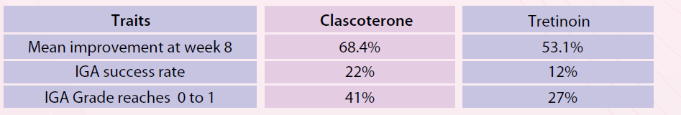
Clinical efficacy
Topical clascoterone was clinically superior to topical tretinoin for treating mild-to-moderate acne vulgaris.
M. H. GOLD, Clascoterone cream (1%) topical androgen receptor inhibitor for the treatment of acne in patients 12 years and older, EXPERT REVIEW OF CLINICAL IMMUNOLOGY 2021, VOL. 17, NO. 4, 301–308

Slide 25
Conclusion
Acne vulgaris is an inflammatory skin condition that typically affects teens and adolescents, although it can expand to affect other age groups.
There are several pathophysiologic pathways in the emergence of acne vulgaris. These pathways involve follicular hyper keratinization, overactive sebaceous glands, Cutibacterium acnes colonization, and inflammation. Therefore, the role of current acne treatments is to target these specific pathogenic factors.
At present, there are many topical treatments for acne available, including benzoyl peroxide (BPO), antibiotics, retinoids, dapsone, azelaic acid, and sulfur; however, patients often do not get a good response with these agents, and having better treatment options would be beneficial.
Androgens are hormones that regulate sebum production and play a key role in acne pathogenesis, contributing to symptom onset and persistence.

Slide 26
Conclusion
Antiandrogens can be effective for acne when given systemically. Spironolactone, a moderate androgen receptor blocker, has been used off-label, and oral contraceptives have been Food and Drug Administration approved for the use of acne. However, these agents are limited for use in women, and have systemic adverse effects.
Clascoterone 1% cream is a novel topical antiandrogen medication indicated for patients with acne vulgaris (both female and male) who are 12 years of age or older.
In clinical trials, at week 12, clascoterone met all three coprimary efficacy end points: proportion of patients achieving treatment success, absolute change from baseline in non-inflammatory lesion count (NILC), and absolute change from baseline in inflammatory lesion count (ILC).
The safety and efficacy of clascoterone for the treatment of acne has been demonstrated in numerous preclinical and clinical trials. Most common adverse events were local skin reactions but systemic adverse reactions were insignificant.
Clascoterone 1% cream is a novel first-in-class topical androgen receptor inhibitor for the treatment of acne vulgaris and represents the first new mechanism of action for acne treatment in almost 40 years and is an excellent antiandrogen therapy for topical use.

